Slide 1

Application: ParkEz Type: Application Architecture View: Logical View Style: Layered Architecture Pattern
Users
Delivery Channels
Core Business Processes
Data And Information
Technology Enablers
Count Cars
User Information
Connection for Database (Postgresql)
Subscribed Parking Lot Operators
Track Plates
Ad Metrics
Lot Footage (HTTP HLS)
Customer Support Specialist
Get Best Space
Ad Content
User Interface (React)
Car Parking Users
Browser
Find Over parkers
Camera Feed
Application Hosting Server (Vercel)
Place Ads
Saved footage
Subscribed Advertisers
Github & Delivery Pipeline
View Footage
Lot Data
Accountant
Access Old Footage
Support Requests
ML Space Recognition (AlexNet)
Ad & Sales Rep
Request Support
Payment Data
Payment Process System
Manager

Slide 2
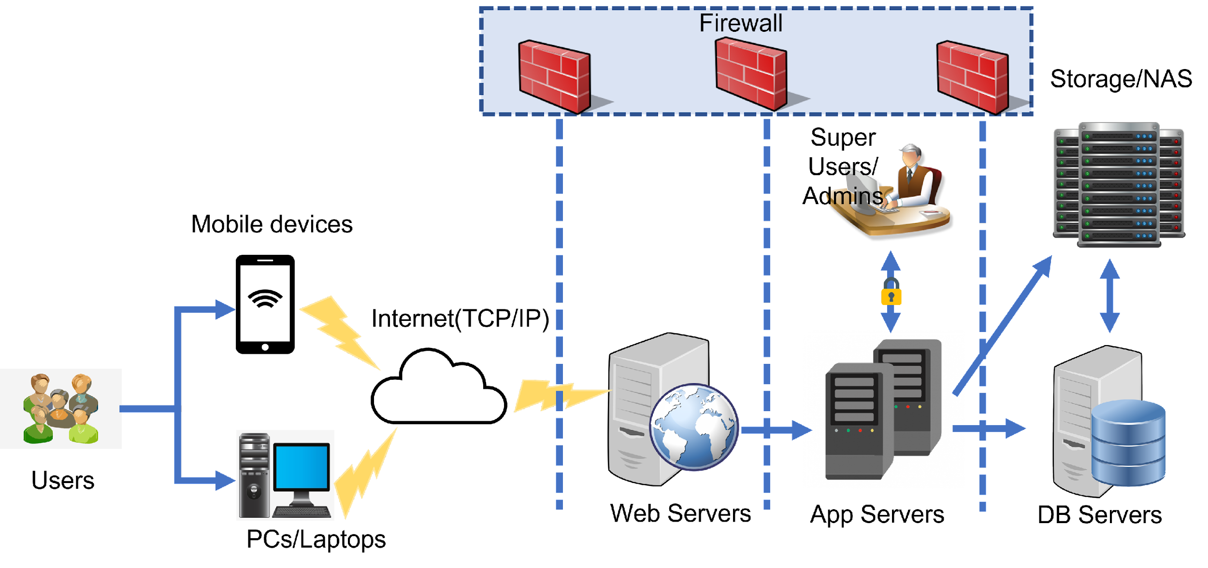

Application: ParkEz Type: Application Architecture View: Process View Style: Client-Server Pattern
Lot Camera feed

